Slide 1
Learning Aim A:
Unit 1: Fitness for Sport and Exercise
Exercise Intensity

Slide 2
Unit Content
Copy this into your notebook:
Topic A.4 Exercise Intensity and how it can be determined
Exercise Intensity
Training Zones
Borg Scale/RPE Scale

Slide 3
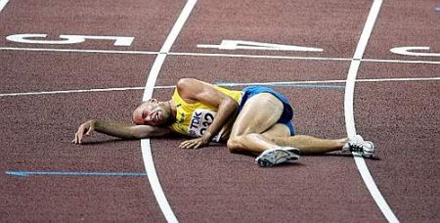
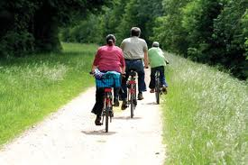
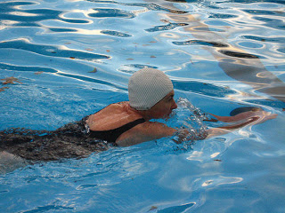
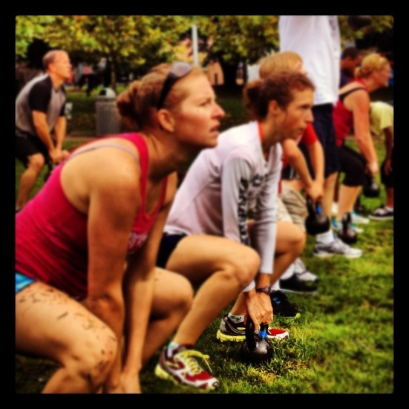
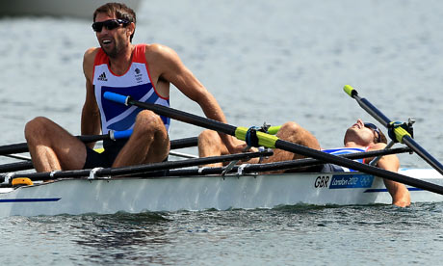
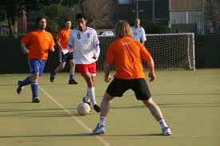
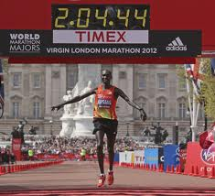
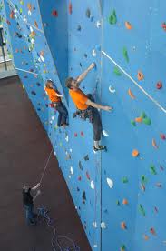
Connector
How hard do you think each person is working?

Slide 4
Learning Aims
All: will understand how exercise intensity is measured
All: will understand the training zone required to improve cardiovascular health and fitness
Most: will understand how to adjust exercise intensity to increase health and fitness
Some: will be able to recommend ways to increase exercise intensity

Slide 5
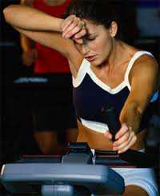
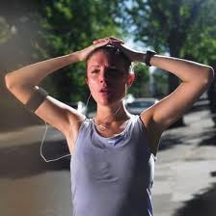
Intensity
Copy this into your book
“How hard training will be.”
Why does our Heart Rate get faster during exercise?
Q. How do we know how hard we are training?
Q. What physical change could tell us how hard we are working?
We can use our heart rate to monitor how hard we are working during exercise. The harder we work the higher our heart rate should be.

Slide 6
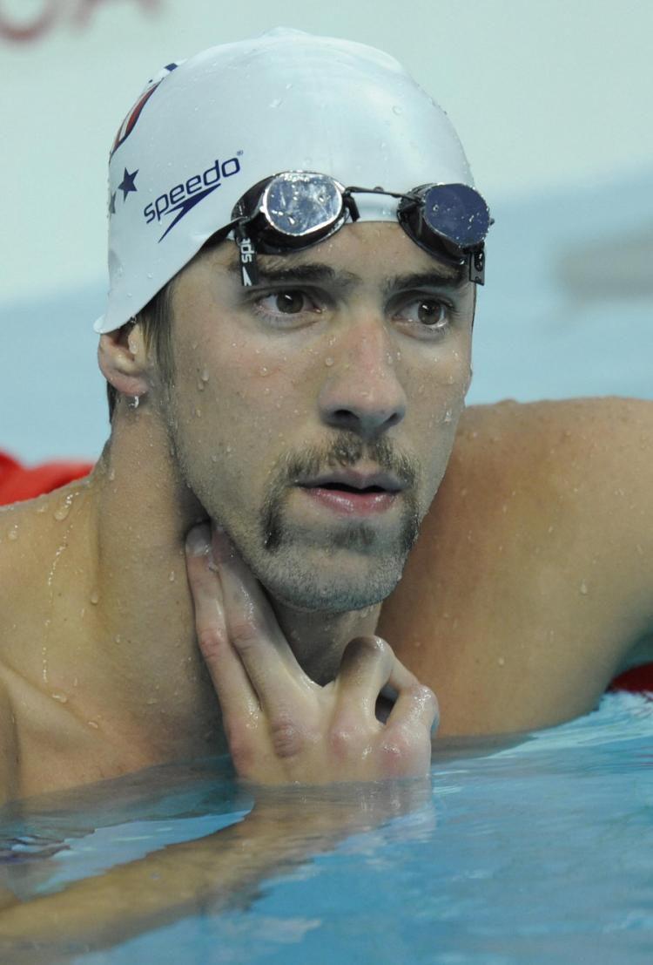
Heart Rate Challenge
You are going to record your Resting Heart Rate
Find your HR on your wrist/neck
On the teachers instructions count the number of pulses you feel in 30 seconds
Double your number . . . This is your Resting Heart Rate
Write it into your workbook:
Resting Heart Rate = ? BPM
CHALLENGE
Run as fast as you can on the spot for 30 seconds….
Calculate your working heart rate (write it into your book)
How does it compare with your estimation?
What intensity were you working at?
Is this reflected in your working heart rate?
You are now going to calculate your Working Heart Rate
In your book estimate what you think your working heart rate will be after 30 seconds of running on the spot
Estimated Working Heart Rate = ? BPM

Slide 7
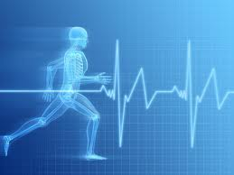
Maximum Heart Rate
To calculate how hard we should be working we are able to use our maximum heart rate.
What is your maximum heart rate?
Maximum HR = 220 – age = ?
What is maximum heart rate?
Maximum Heart Rate is the highest number of beats our heart can produce per minute.
We calculate maximum heart rate by subtracting our age from 220.
Eg. 20 Year Old Athlete’s Maximum HR
220 – 20 = 200 BPM

Slide 8
Training Zones
TASK
Complete the blank training pyramid
Training zones are used to monitor the intensity an athlete is completing a training session.
Each training zone will improve specific types of fitness and energy systems.
Training zones are calculated using an athlete’s working heart rate.
Higher Intensity & Shorter Duration
The recommended training zone for cardiovascular health and fitness is:
60 – 80% HR max

Slide 9
Can you calculate your training zones?
60-80% HR Max
Remember to calculate a percentage you divide you HR max by 100 and multiply by the percentage number!
Eg. 60% of HR max for a 24 year old is:
196 ÷ 100 × 60 = 118

Slide 10
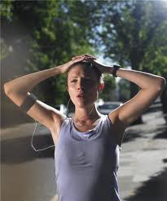
Borg Scale
15 Point Scale
6 - 20% effort
7 - 30% effort - Very, very light (Rest)
8 - 40% effort
9 - 50% effort - Very light - gentle walking
10 - 55% effort
11 - 60% effort - Fairly light
12 - 65% effort
13 - 70% effort - Somewhat hard - steady pace
14 - 75% effort
15 - 80% effort - Hard
16 - 85% effort
17 - 90% effort - Very hard
18 - 95% effort
19 - 100% effort - Very, very hard
20 - Exhaustion
The Borg Scale (1970) is a simple method to rate an athlete's level of intensity in training and competition.
Rating of Perceived exertion (RPE) is an individual's rating of how hard they are finding the exercise

Slide 11
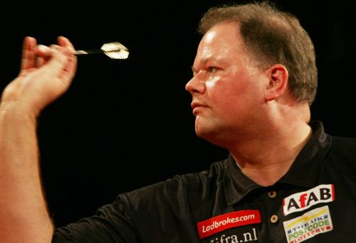
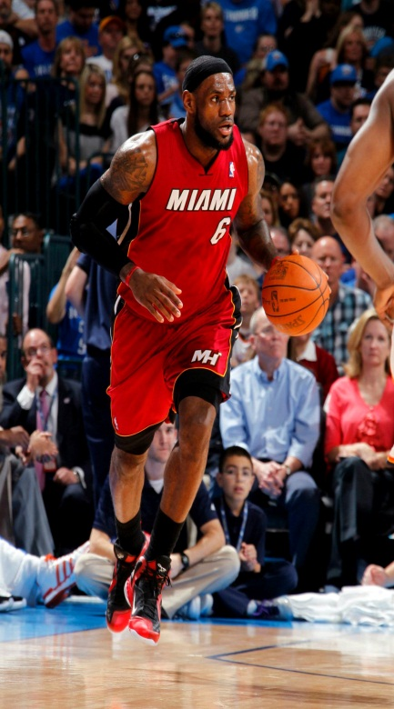
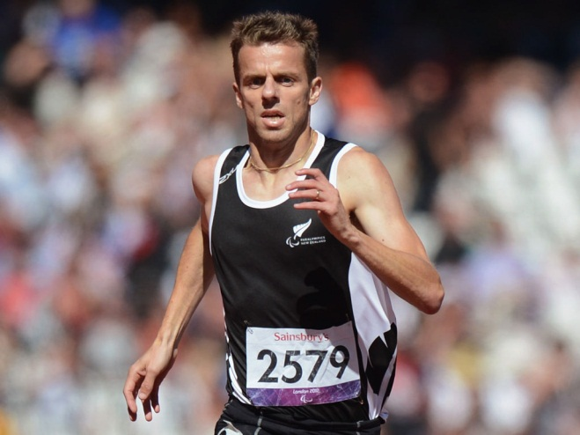
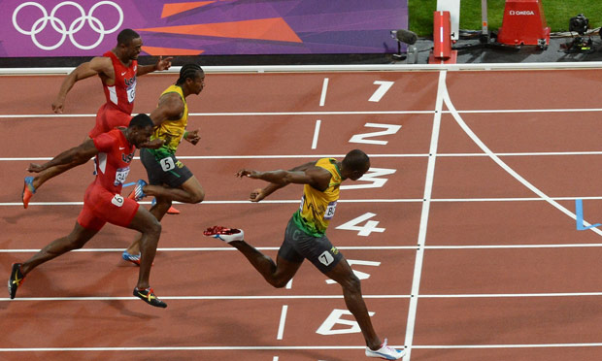
Rating of Perceived Exertion (RPE)
Using the Borg Scale in your notebook give the following sports a RPE score:
What RPE 20 (Exhaustion)
looks like . . .
Notes:
Click on the picture of Tim Pendergast to show students a video of his 5000m performance & stumble to the finish – highlighting what Exhaustion (RPE 20) looks like!

Slide 12
Relationship between RPE & HR
An athlete can use their Rating of Perceived Exertion (RPE) to calculate what their working heart rate should be or vice versa.
RPE × 10 = HR (bpm)
If an athlete rates their run as being a 9 on the Borg Scale what is their working Heart Rate?
If an athlete takes their working heart rate during a circuit training session and it is 110 bpm, what is their RPE?

Slide 13
F.I.T.T. Principle
FREQUENCY –
the number of training sessions completed per week.
INTENSITY –
how hard training will be.
TIME –
how long training sessions will be
TYPE –
selecting a training method to improve a specific component of personal fitness and/or sports performance.

Slide 14
TWEET
You have been asked by FHS to tweet on a personal trainer’s Twitter Page to summarise today’s lesson.
In no more than 140 characters summarise what you have learnt about exercise intensity.

Slide 15
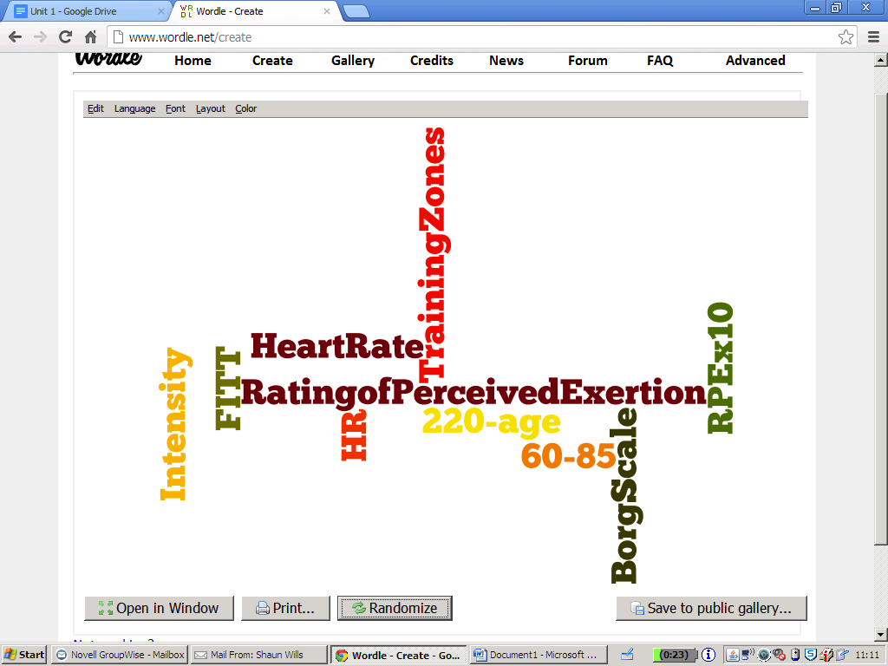
Review
Can you explain the following words to your partner:

