Slide 1
BTEC Level 2 Firsts in Sport
Fitness Training Methods

Slide 2
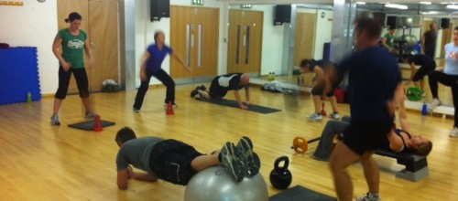
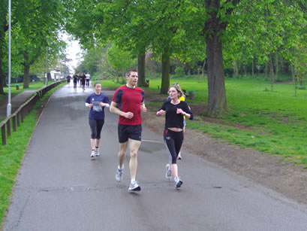
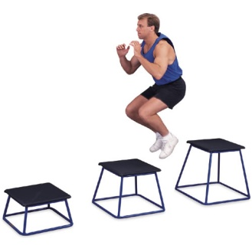
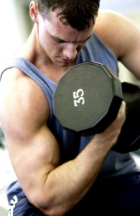
Connector
Try to work out which fitness training methods these pictures represent:
1.
2.
3.
4.

Slide 3
Big Picture
Work in pairs to identify different training needs for individuals.
Take part in some word and definition match activities.
Undertake some research into training methods.
Read scenarios and give advice.

Slide 4
Learning Outcomes
All will understand the basic principles behind three different fitness training methods.
Most will understand the advantages and disadvantages of three different fitness training methods.
Some will understand how principles of training can be used to modify the fitness training methods.

Slide 5
Assessment Links
B.3: Explore different training methods for strength, muscular endurance and power training
B.2: Additional requirements for each of the fitness training methods
What do I need to know?
● advantages/disadvantages of different training methods
● the intensity you need to train at for different fitness training methods
● how to use principles of training to make training methods effective
● know which fitness training method(s) is suited to given situation(s)
● know which fitness training method(s) to suggest for different client needs/goals/aims/objectives.

Slide 6
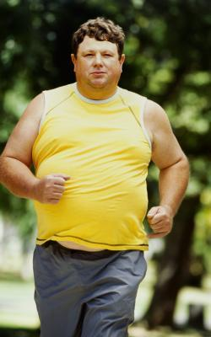
What training?
What type of training would you recommend for this person and why?
Notes:
Low impact Aerobic exercise – weight loss and less stress on joints.

Slide 7
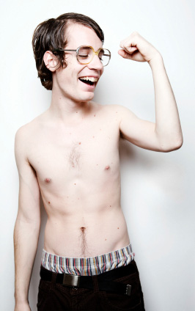
What training?
What type of training would you recommend for this person and why?
Notes:
Weight training / resistance training – muscle hypertrpohy
Low reps high weight – muscle bulk

Slide 8
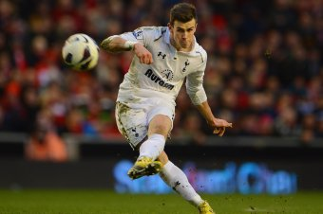
What training?
What type of training would you recommend for this person and why?
Notes:
Aerobic – Aerobic endurance required in football.
Anaerobic – Sprinting required in football.
Resistance / weight training – Muscular strength required.

Slide 9
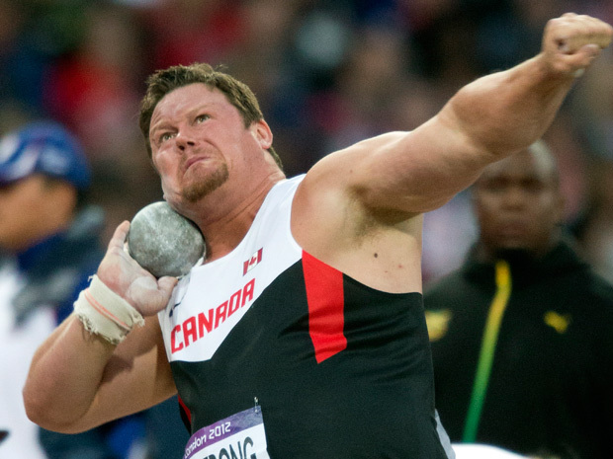
What training?
What type of training would you recommend for this person and why?
Notes:
Weight / Resistance training – Muscular strength and power required.

Slide 10
Strength, muscular endurance and power training
What types of exercise or training can be used to develop the following components of fitness?
STRENGTH
MUSCULAR ENDURANCE
POWER
Notes:
Short group discussions / thought shower where pupils identify which training could develop which components.

Slide 11
Match up the component of fitness with ideas of how to develop it using weight training
COMPONENT OF FITNESS
STRENGTH
MUSCULAR ENDURANCE
POWER
HOW TO DEVELOP COMPONENT
Developed by moving lighter weights for a high number of repetitions.
Developed by performing exercises and lifting weights at high speed.
Developed by moving a heavy load for a low number of repetitions.
Notes:
Can be done as a word match or put on the board.

Slide 12
Distillation (Page 14 from textbook)
Read through the resource provided and write down any key words.
You may be asked to write these on the board.
Now as a class, come up with 5 key words which you think relate to free weight training.
Notes:
Photocopy page 14 from the BTEC Level 2 Firsts in Sport
Pupils read the information and write down key words.
Class then decides which words are key to understanding the topic.

Slide 13
Using those key words
Using the 5 class key words, now write a short paragraph which describes what free weight training is.
‘Free weight training is………….’
Notes:
Pupils now use the common key words to write a paragraph which describes / explains what free weight training is.

Slide 14
Task 1
Use the hand out to try to work out some information about free weights training.
Find out:
What the training method involves?
What are the advantages?
What are the disadvantages?
How can the training method be adapted?
Notes:
Give pupils the free weights resource sheet.
Their task is to make notes on the following 4 areas.
You may wish to differentiate the resource for higher ability pupils.
You may wish to do this activity Task 1-3 as a carousel or in groups of 3 in knowledge groups.

Slide 15
Task 2
Use the hand out to try to work out some information about circuit training.
Find out:
What the training method involves?
What are the advantages?
What are the disadvantages?
How can the training method be adapted?
Notes:
Give pupils the circuit training resource sheet.
Get pupils to make notes.

Slide 16
Task 3
Use the hand out to try to work out some information about plyometrics training.
Find out:
What the training method involves?
What are the advantages?
What are the disadvantages?
How can the training method be adapted?
Notes:
Give pupils the plyometrics resource sheet.
Same as previous task.

Slide 17
Recap of principles of training
PRINCIPLES OF TRAINING
FREQUENCY
INTENSITY
TIME
TYPE
DEFINITIONS
This is how hard you train.
This is how long you train.
This is how often you train.
This refers to what sort of activity is done.
This refers to taking part in more sessions in order to improve fitness.
This refers to training for longer periods in order to improve fitness.
This refers to training harder in order to improve fitness.
This refers to the ideology that the training you do needs to match the activity that you are training for.
Notes:
This can be done as a word match or whole class activity to recap the main principles of training.

Slide 18
Scenario Time
Andy is a college student who is studying a sports qualification. He is passionate about football and plays for an amateur Sunday league team. He wants to improve his performance in football. Currently, he finds that he is pushed off the ball too easily. He currently only trains once a week in the gym and stops after 15 minutes.
What advice can you offer him and why?
Notes:
Pupils work in groups. Discuss or write down opinions.
Pushed off the ball – undertake free weight training. (TYPE)
Only trains once a week – train more times a week. (FREQUENCY)
Stops after 15 minutes – train for longer duration. (TIME)

Slide 19
Scenario Time
William is training to be a long distance runner. He has started working out in the gym but has recently noticed that he has gained muscle bulk. This is slowing him down. He enjoys going to the gym because he finds it interesting. He has also started doing some sprint training but it has not helped him because he still ends up experiencing high levels of fatigue towards the end of the long distance events. Sometimes he cannot finish the events.
What advice can you offer him and why?
Notes:
Gained too much muscle bulk – Lighter weight, higher repetitions. (TYPE)
Sprint training – Alter this as he is a long distance runner, needs to do more aerobic training. (TYPE)
Fatigue – Not enough aerobic endurance training. More aerobic activity sessions required. (FREQUENCY)

Slide 20
Scenario Time
Isabelle is a professional badminton player who has recently started to underperform in big tournaments. She was ranked number 2 but has now dropped to number 10 in the world. She recently changed coaches and has started to take it easier in sessions and is not giving all her effort because she knows that she can get away with it. She has good aerobic endurance and does not tire but she find it difficult to change direction. She also has difficulty when sprinting around the court to reach the shuttle and starts getting out of breath and tired quickly. She has neglected these factors from her training programme.
What advice can you offer her and why?
Notes:
Knows she can get away with not putting in full effort – train harder and to full capability. (INTENSITY)
Difficult to change direction – work on agility. (TYPE)
Difficult to sprint – sprint training. (TYPE)

Slide 21
Sport Performer Profile
Pick a sports performer.
Identify which methods of training they should undertake and explain why.
Identify how the different principles of training should be implemented within their training programme.
Notes:
Pupils use the sports performer profile to create a training profile for a sports performer of their choice.
These can then be presented back to the class.

Slide 22
NAME OF PERFORMER: SPORT:
TRAINING METHOD: | WHY IS THIS TRAINING METHOD IMPORTANT?
APPLICATION OF PRICIPLES OF TRAINING: | HOW WOULD YOU APPLY THESE PRINCIPLES OF TRAINING INTO THE SPORTS PERFORMERS TRAINING PROGRAMME?
FREQUENCY
INTENSITY
TIME
TYPE

Slide 23
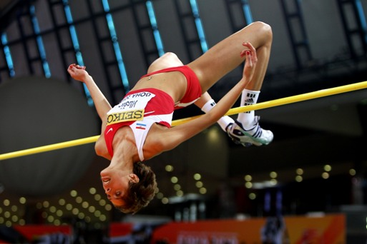
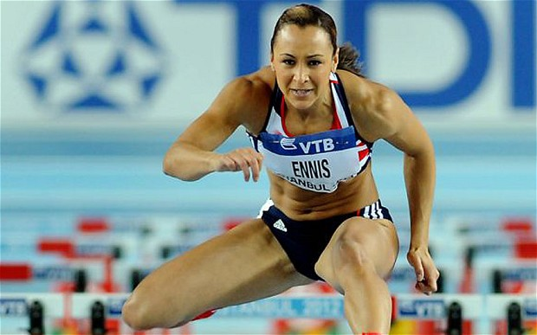
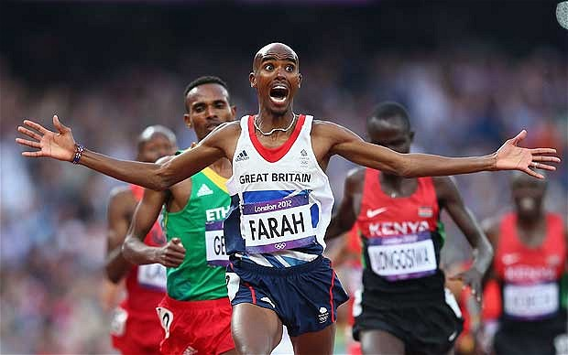
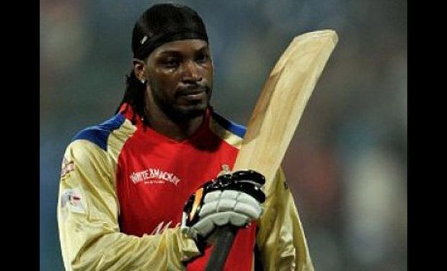
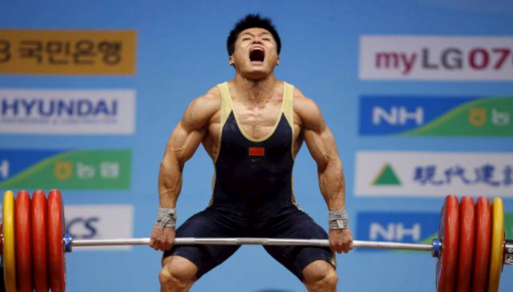
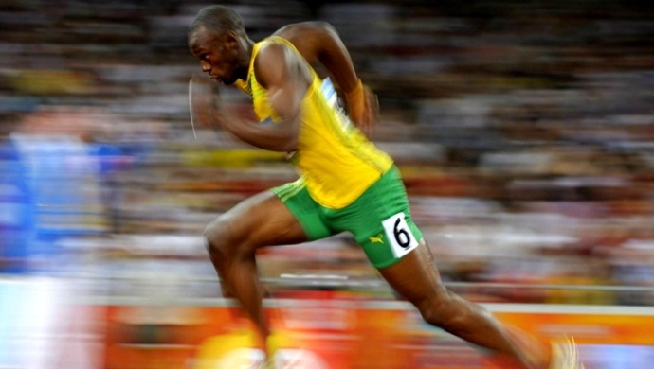
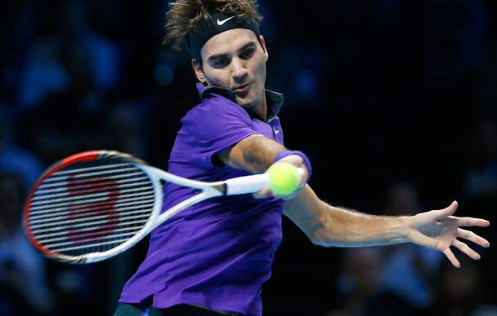
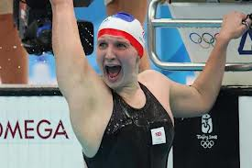
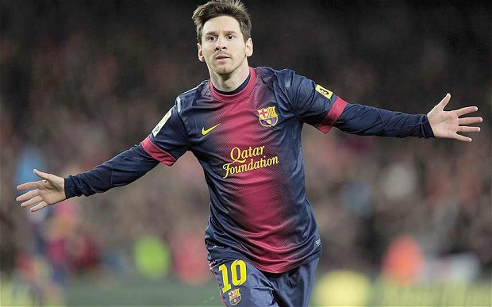
Plenary
Pick a sports performer and briefly explain a training method they should undertake and explain why it would be beneficial.
Notes:
This activity could also be put in as a starter or connector. This could then let you evaluate the progress of pupils through the lesson as you could compare their responses from the beginning of the lesson to the end.

